Slide 1
ATHLONE
Introducing Turas
A wellness and recovery focussed course
Now Enrolling
Please Press Play on next slide

Slide 3
Turas is a training course aimed at people who have experienced Mental Health issues. This person-centred and recovery-focused programme helps students build on their personal and social development and work on confidence and well-being. The course promotes recovery through education and personal development. Full and part-time places available.
Turas = Journey
The only impossible journey is the one you never begin.
– Tony Robbins

Slide 4
Turas provides an opportunity for participants to:
develop personal skills
social skills
make independent choices
explore recreational, social and vocational opportunities and achieve health and social gains.
The course also explores opportunities to work on gaining QQI certification and to progress to further training or employment

Slide 5
What Will I do on the Course ?
Induction
Community & Voluntary Networking
Stress Management
Cultural & Leisure Opportunities
Wellness Module
Relaxation Tools
Mental Health Management

Slide 6
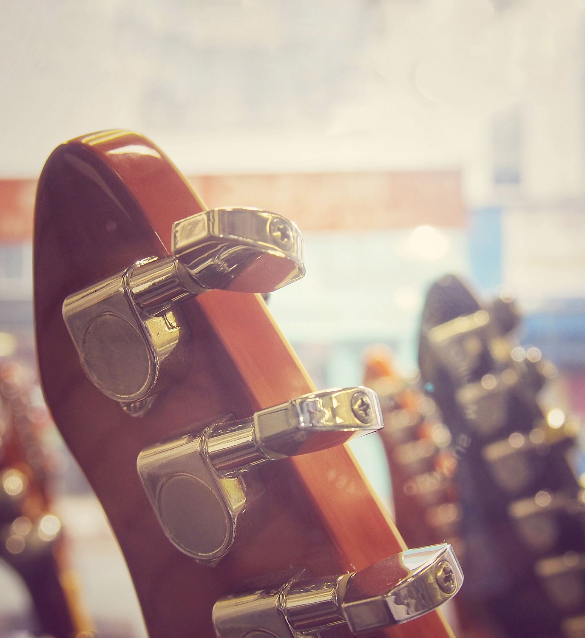
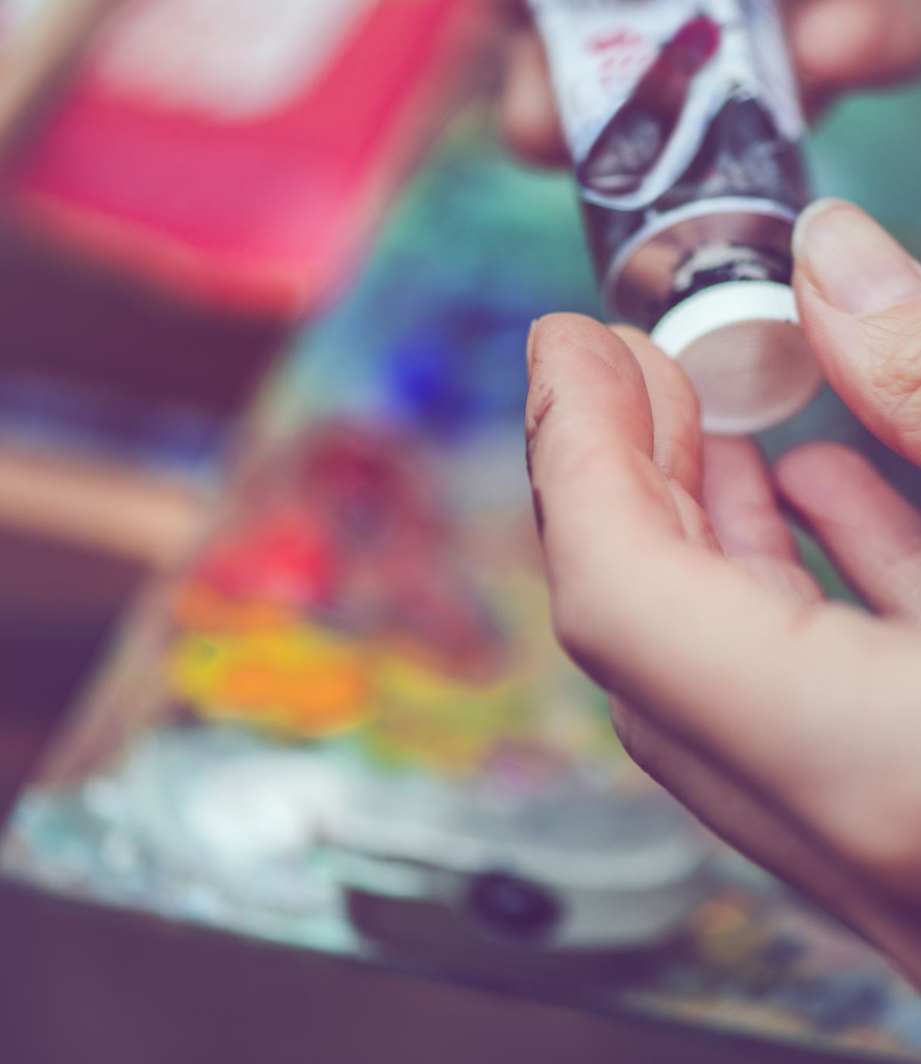
Make friends and become part of the community
Explore Your musical appreciation
Take part in fun creative sessions
Gain confidence to try new things
Check out virtual art gallery by following the link bellow
https://www.artsteps.com/view/5fc8bcd0aa127561dbca1196?fbclid=IwAR0x5d_4ba5ykcpkOGhyj-Tu4-wo3QXXMs-46-qGzoLAlG0HICdCmeyZ9KA

Slide 7
Contact
Contact us today to find out more
Visit
Visit: www.nln.ie
Email
Email: emily.garavan@nln.ie
Call
Call Turas at: 0860455518
Address
Address: NLN Athlone, Belhavel, Golden Island, Athlone, County Westmeath

